Slide 1


Group 5

Slide 2
What is Go Nuts?
A competitive networked multiplayer racing game for 3-5 players
Simultaneous, symmetric gameplay
PC standalone, keyboard & Mouse
8 minute playtime
Males aged 10-15
Overall goal:
Obtain 2 nuts before anyone else
Reach the far end of the level
Grab a nut
Return to base

Slide 3
Changes Since Beta
Animated models
Major bug fixing for multiplayer
New skybox and lighting
HUD Changes
Gameplay tweaks
Tutorialisation

Slide 4
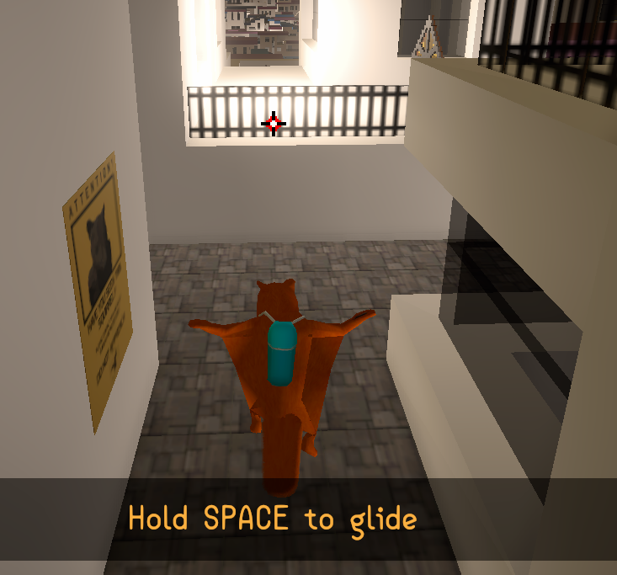
Animated Models
Low poly Model adapted
Animations created for –
Starting
Gameplay
Running
Jumping
Gliding
Grappling

Slide 5
Bug Fixing

Slide 6
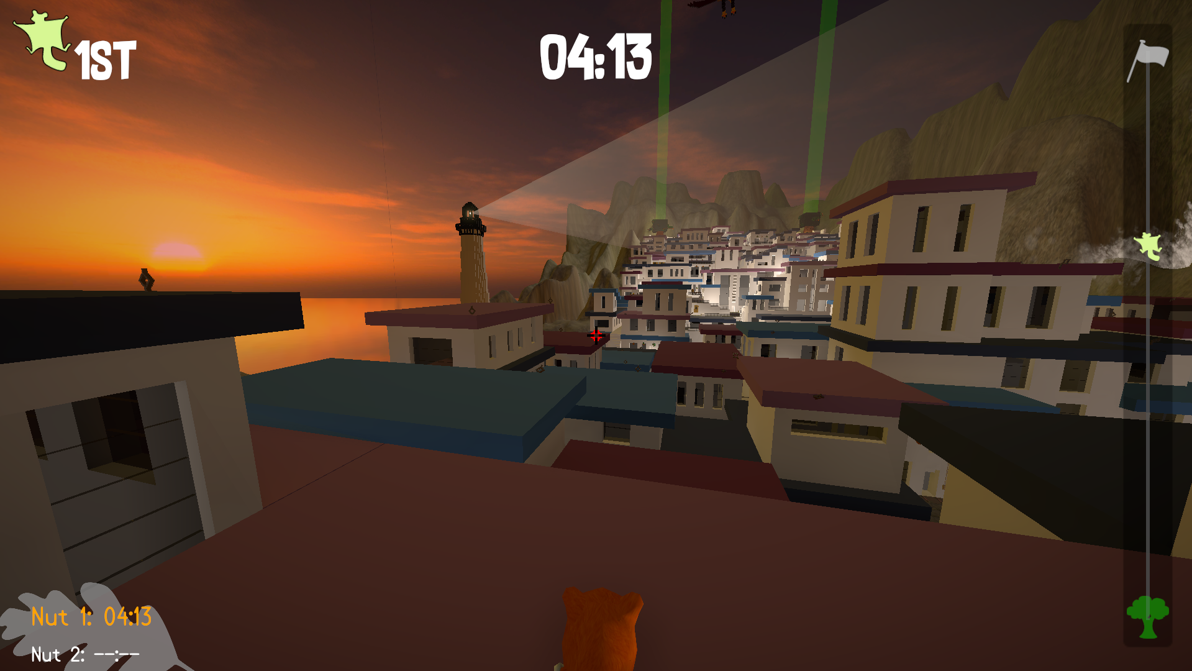
New Skybox and Lighting

Slide 7
Gameplay
Gameplay Video

Slide 8
Feedback
Graphs here
“Loved the character and the overall outlook.”
“I also liked the way the obstacles looked and the distinct goals of the game.”
“Getting picked up by the Eagle, makes it impossible to move on in the game.”

Slide 9
Questions?
Elliot Page – Max Carter – Zachari Cooper – Rebecca Brannum – Joe Wilson

